Slide 1
IENG 6912 Term Project
Presented by Jamil Sinno
December 4, 2017

Slide 2
Problem Overview
A student would like to travel to Europe for a 30 day vacation
This problem was derived from the Travelling Salesperson Problem
List of potential countries the student wants to visit:
Iceland
England
France
Spain
Italy
Germany
Belgium

Slide 3
Who this would help?
To reward themselves with graduating from school, students often reward themselves with extended trips to Europe
Students often get frustrated with trying to find the optimal route to fit their budget
Solving this problem using an algorithm would drastically reduce the time needed to figure out the best route since there are so many options
Given the program can take the input of its user into account, this program would help students route their vacation minimizing their cost
This would help out a lot of travelers who are planning on travelling to Europe and minimizing their cost without worrying about distance traveled

Slide 4
Problem Overview
The student would like to visit six different countries and minimize the cost
Once a country has been visited, it cannot be visited again
The route taken must start and end in Halifax
Since there are seven countries on the list, the student must choose between visiting Belgium or Iceland
The student’s final destination must be England
The student would like to stay 7 days in England
The student wants to stay in each country at least 3 days

Slide 5
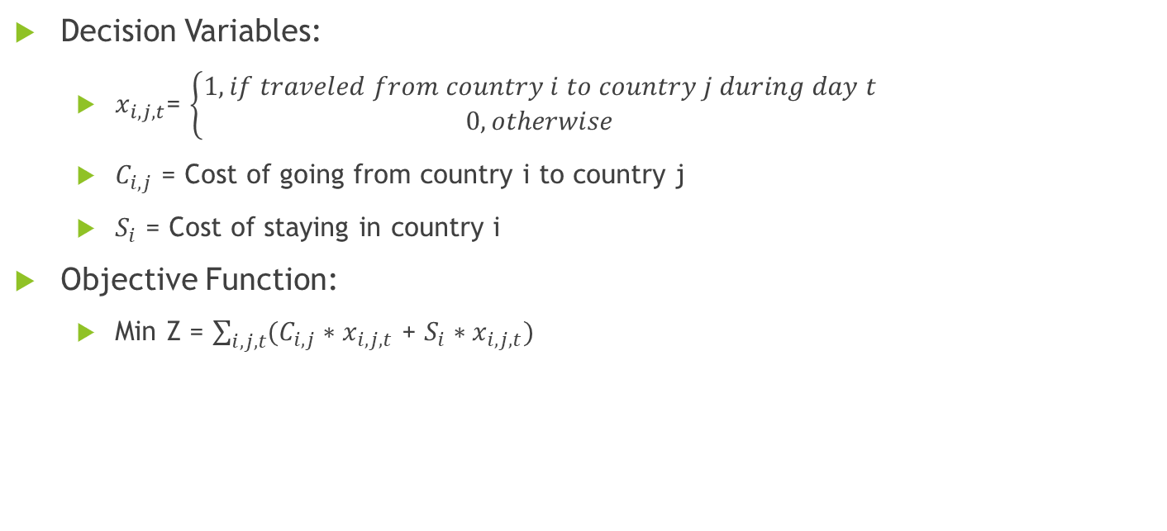
Mathematical model
Decision Variables:
$x_{i,j,t}$= $\left\{\begin{aligned}1, if traveled from country i to country j during day t \\ 0, otherwise\end{aligned}\right.$
$C_{i,j}$ = Cost of going from country i to country j
$S_{i}$ = Cost of staying in country i
Objective Function:
Min Z = $\sum_{i,j,t}{(C_{i,j}∗x_{i,j,t}\text{ + }S_{i}∗x_{i,j,t})}$

Slide 6
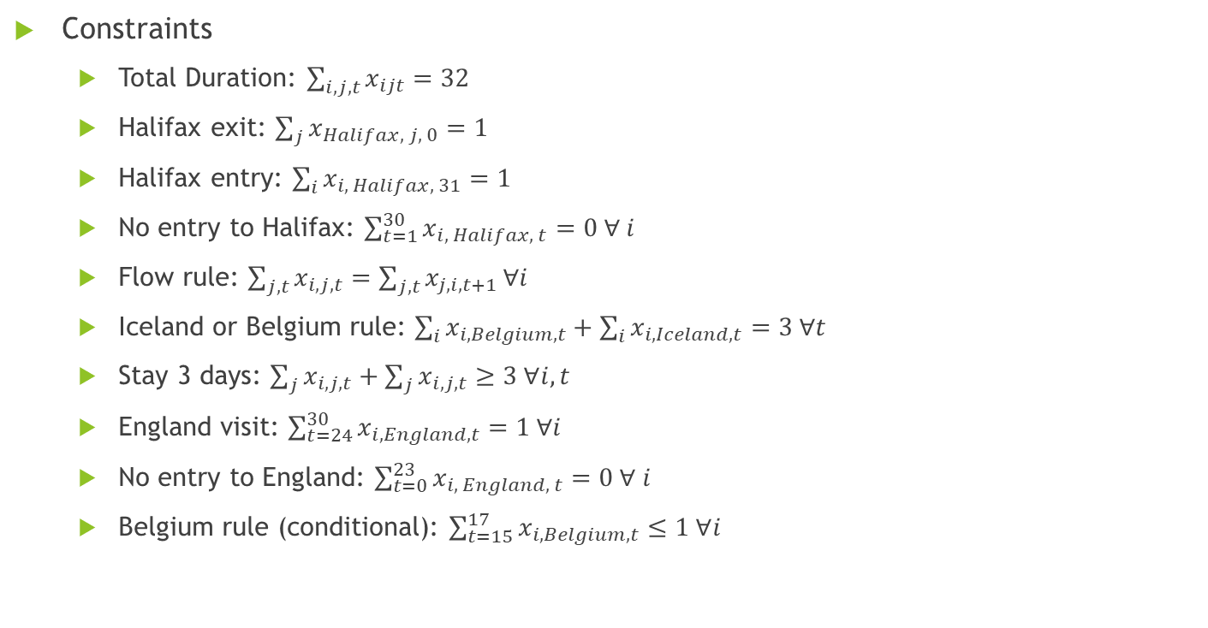
Mathematical Model Ctd.
Constraints
Total Duration: $\sum_{i,j,t}{x_{ijt}=32}$
Halifax exit: $\sum_{j}{x_{Halifax, j, 0}=1}$
Halifax entry: $\sum_{i}{x_{i, Halifax, 31}=1}$
No entry to Halifax: $\sum_{t=1}^{30}{x_{i, Halifax, t}=0 ∀ i}$
Flow rule: $\sum_{j,t}{x_{i,j,t}=\sum_{j,t}{x_{j,i,t+1}}}∀i$
Iceland or Belgium rule: $\sum_{i}{x_{i,Belgium,t}+\sum_{i}{x_{i,Iceland,t}=3 ∀t}}$
Stay 3 days: $\sum_{j}{x_{i,j,t}+\sum_{j}{x_{i,j,t}≥3 ∀i,t}}$
England visit: $\sum_{t=24}^{30}{x_{i,England,t}=1 ∀i}$
No entry to England: $\sum_{t=0}^{23}{x_{i, England, t}=0 ∀ i}$
Belgium rule (conditional): $\sum_{t=15}^{17}{x_{i, Belgium, t}≤1 ∀i}$

Slide 7

Cost of travelling ($C_{i,j}$)
Cities | Halifax | Iceland | England | France | Spain | Italy | Germany | Belgium
Halifax | $0 | $1481 | $748 | $790 | $938 | $883 | $986 | $755
Iceland | $1481 | $0 | $153 | $362 | $389 | $453 | $408 | $223
England | $748 | $153 | $0 | $34 | $93 | $50 | $86 | $138
France | $790 | $362 | $34 | $0 | $64 | $34 | $134 | $211
Spain | $938 | $389 | $93 | $64 | $0 | $187 | $201 | $209
Italy | $883 | $453 | $50 | $34 | $187 | $0 | $144 | $179
Germany | $986 | $408 | $86 | $134 | $201 | $144 | $0 | $53
Belgium | $755 | $223 | $138 | $211 | $209 | $179 | $53 | $0
Note: Numbers extracted from Google Flights on Nov. 21, 2017

Slide 8

Cost of staying ($S_{i}$)
City | Cost ($/day)
Halifax | 0
Iceland | 35
England | 50
France | 50
Spain | 45
Italy | 40
Germany | 40
Belgium | 35
Note: Numbers estimated for sake of problem

Slide 9
Results
Optimal route:
Halifax -> Italy -> France -> Spain -> Belgium -> Germany -> England -> Halifax
Total Cost of trip:
$3327
Time taken to solve problem:
13.8 seconds
Days resided in each country:
Solver used:
Python(Pyomo): GLPK
Country | Days resided in country
Italy | 8
France | 3
Spain | 3
Belgium | 3
Germany | 6
England | 7

Slide 10
Iterations
There is no cookie cutter solution
Problem is quite complex
Program initially had a tough time attempting to solve the problem
Needed to reduce number of variables in problem
Problem needed to be altered to attain a feasible solution – needed to add minimum days required to stay in a country
Without forcing the flow, the problem took well over 10 minutes to be solved with original objective function
If the minimum number of days was increased, the problem has no feasible solution

Slide 11
Implementation
A code like this would best be implemented as a website or an app accessible to the general public
While this problem was tailored for students due to how common it is that they travel to Europe. The general public could use the same program for the same purpose
The code would have to be adapted to have expand on the list of countries available to serve a broader audience
The code could then be sold to larger companies or used as a start-up and as a consulting company

Slide 12
Metaheuristic
Metaheuristic used for this problem was simulated annealing
The number of constraints needed to be reduced for the metaheuristic to solve
Simulated annealing would be the best heuristic to choose because of the way the algorithm solves the problem
Each iteration in simulated annealing process produces a potentially better solution and drastically reduces the amount of time needed to find the optimal solution
With a feasible solution, simulated annealing selects two edges, swaps them, producing a new route in hopes to find a better result

Slide 13
Initial Solution
Chose initial solution:
Halifax -> Germany -> France -> Belgium -> Italy -> Spain -> England -> Halifax
Total cost:
$3858
Country | Days resided in country
Germany | 3
France | 4
Belgium | 4
Italy | 6
Spain | 6
England | 7

Slide 14
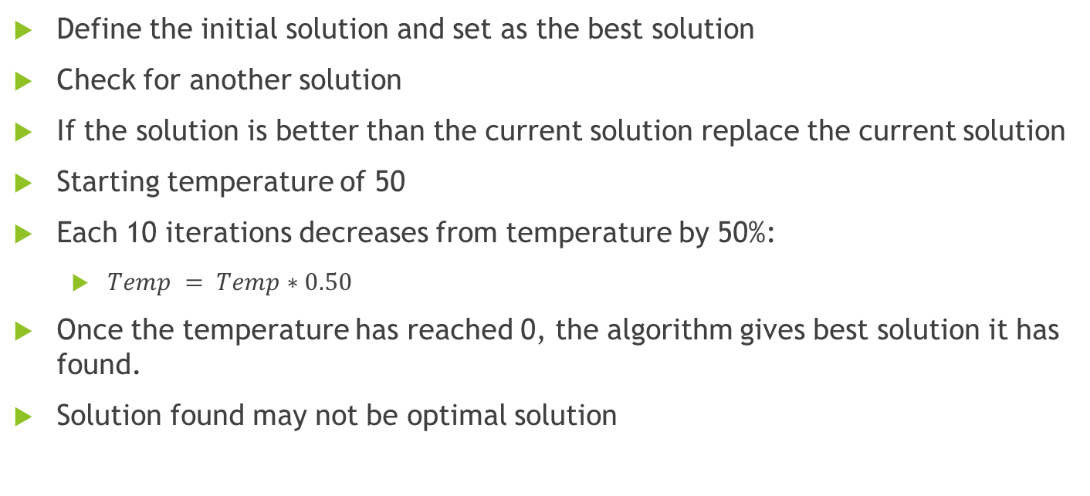
Metaheuristic Steps
Define the initial solution and set as the best solution
Check for another solution
If the solution is better than the current solution replace the current solution
Starting temperature of 50
Each 10 iterations decreases from temperature by 50%:
$Temp = Temp∗0.50$
Once the temperature has reached 0, the algorithm gives best solution it has found.
Solution found may not be optimal solution

Slide 15
Metaheuristic results
Due to complexity of the problem with regards to the variables, a feasible solution could not be achieved
Displays how difficult the solution is with regards to the given constraints
Optimally, had the simulated annealing method had come up with a solution it would have achieved the same result as the mathematical solution

Slide 16
Thank you for listening. Questions?

